Slide 1
Stock Price Movement Predictor
By Danny Zhen and Sushobhan Parajuli

Slide 2
Who we are
Danny Zhen
College: Baruch College
Expected Graduation: Spring 2022
Major: Statistics & Quantitative Modeling
Contacts:
https://www.linkedin.com/in/dannyzhen/
https://github.com/dannyzhen2000
danny.zhen@baruchmail.cuny.edu
Sushobhan Parajuli
College: Baruch College
Expected Graduation: Fall 2022
Major: Mathematics
Contacts:
https://www.linkedin.com/in/sparajuli/
https://github.com/Sushobhan55/
sushobhan.parajuli@baruchmail.cuny

Slide 3
About the Project
Goal: Understand randomness in stock price due to News headlines
Approach: Use NLP algorithms to classify news headlines
Why: News headlines carry information, opinions and sentiments. Classifying the news headlines based on sentiments and information can help traders make trading decision
“Apple's iPhone 13 production fell 20% in Sept-Oct" — conveys a negative outlook — negative investors sentiment — downward price movement

Slide 4
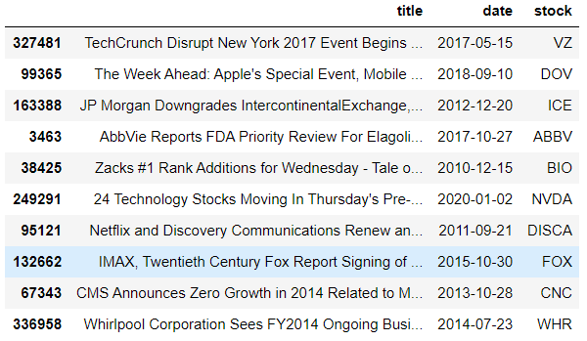
Our Dataset(Initial)
Dataset of about 337226 headlines from Kaggle containing information from 2009 to 2020
title: headline of the news article
date: date of when the article was published
stock: ticker of stock headline is referring to

Slide 5
Data Cleaning and Feature Engineering
Lowered the alphabets
Removed:
Duplicated rows
Numbers
Punctuations
Stopwords
Eg: 'the', 'to', 'and', 'a', 'in', 'it', 'is', 'I', 'that', 'had', etc
Used historical prices to create new ‘is_up’ column

Slide 6
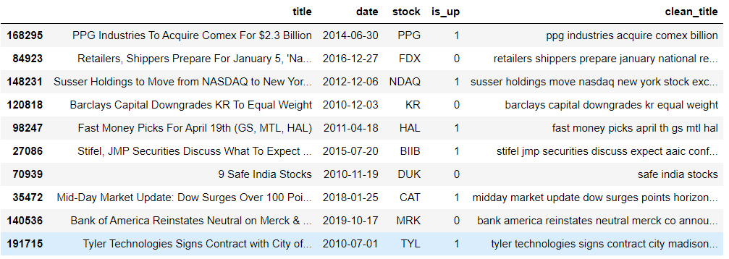
Our Dataset(Cleaned)
330538 headlines after cleaning
is_up: 1 indicates stock went up, 0 indicates stock went down
clean_title: same as title, but after it has been processed to be use in our model
Notes:
Go into how dataset was combined

Slide 7
Natural Language Processing Model
Feature Value
Tokenization
Vectorization
Feature: text in clean_tile column
Breaking down text (our feature value) into words and phrases called tokens
Transformation of tokens (words and sentences) into arrays of numbers
TF-IDF vectorizer
Model Building
Saved vectorizer & Model
Results
Input transformed tokens to classifiers
Multinomial Naive Bayes
Faster than NN, however similar accuracy
Neural Networks
Use TF-IDF vectorizer and Multinomial Naive Bayes to classify testing data.
Testing data is parsed from FinViz.com
Predictions : Up (1) or Down (0)

Slide 8
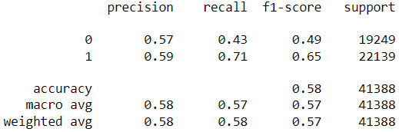
Model Performance
Not a higher accuracy
Future Task: More feature values, higher accuracy
Notes:
Mention nlp, naive bayes

Slide 9














Tech we used
WEB DEVELOPMENT
WEB SCRAPING
DATA ANALYSIS AND MODEL BUILDING
CODE MANAGEMENT
Notes:
MODEL BUILDING: PANDAS, NUMPY, YFINANCE, SK LEARN, NLTK, T-F
WEB DEV: FLASK, JINJA2, HTML, CSS
WEB SCRAPING (FOR EXTRACTING TESTING DATA): PYTHON BEAUTIFUL SOUP, FINVIZ
VERSION CONTROL (CODE MANAGEMENT): GIT, GITHUB

Slide 10
Let’s check out our website

Slide 11
Thank you!
Any Questions?

